Slide 1
Lecture Test 1 Packet
An Introduction to Microbiology and Basic Chemistry

Slide 2
A. What is microbiology? - it is the study of organisms that are too small to be seen with the naked eye; the study of microbes or microorganisms - “bugs” and “germs” are terms usually used by the media to describe microorganisms, but these are NOT generally used by microbiologists any more.

Slide 3
Examples of organisms studied by microbiologists: - viruses - bacteria - protozoa - algae - fungi - invertebrate animals (worms and insects)

Slide 4
All of the examples above are currently considered to be living things (organisms) except perhaps one; EXPLAIN*: VIRUSES do not currently belong to any of the kingdoms of living organisms and they do NOT show all of the characteristics we typically think of when describing an organism. Viruses: noncellular, parasitic, protein-coated genetic elements

Slide 5
A Bacteriophage Virus - viruses have no cell parts; there is no cell membrane, cell wall, ribosomes nor organelles (You don’t treat viral infections with antibiotics because of this). - they also never have DNA and RNA, only DNA OR RNA.

Slide 6
What are the characteristics usually seen in living things? - they are made of cells (this is a part of the CELL THEORY which states: 1. all living things are made of cells 2. the smallest living thing is a cell 3. all cells come from pre-existing cells) - they are highly organized - they utilize energy (this is why you eat and breathe) - they reproduce * - they evolve * - they have definite life spans - they respond to stimuli

Slide 7
The Scope of Microbiology

Slide 8
The Scope of Microbiology

Slide 9
B. Why Do People Study Microbiology? 1. Should our goal be to eliminate all microbes from the planet? If we eliminated our normal bacterial flora would there be a consequence? If we eliminated saprophytic bacteria and fungi, would there be a consequence? People have studied microbes out of curiosity to find out why they are here and what they do; in so doing, we have found out that life on our planet depends upon microbes.

Slide 10
2. People study microbiology because it has practical $$$$ applications in industry $$$$. The Food Preparation Industry- packaged, processed and restaurant foods companies are all interested in knowing how microbes will affect their food and the people who eat it.

Slide 11
The Microbial Fermentation Industry makes: bread (Saccharomyces spp.) beer (Saccharomyces spp.) wine (Saccharomyces spp.) vegetables- sauerkraut, pickles, soy sauce, tofu, poi, olives and chocolate ☺ vinegar (Saccharomyces and Acetobacter) fermented milk products such as yogurt (Streptococcus thermophilus and Lactobacillus bulgaricus), cheeses, sour cream, buttermilk

Slide 12
SINGLE CELL PROTEIN sources- Spirulina (Cyanobacteria) INDUSTRIAL PRODUCTS Pharmaceuticals Food additives Enzymes Bioengineering of transgenic plants and animals to produce hundreds of products Mining Biofuels and Industrial Products Biodeterioration is another concern for many industries because microbes can destroy the products that they sell.

Slide 13
SOIL FERTILITY - farming depends upon microorganisms WASTE DISPOSAL and POTABLE WATER - sewage treatment and water treatment requires a knowledge of microbes BIOREMEDIATION - an “up and coming” industry that attempts to find microbes which can be used to solve environmental problems eg: restore stability or to clean up toxic pollutants

Slide 14
3. Microbes are easy to study and are used for RESEARCH PURPOSES. - microbes are small, simple, inexpensive, reproduce rapidly and are adaptable - the biochemistry and genetics of all living organisms is basically the same - much of current technology depends upon the research done using microbes

Slide 15
4. You will be microbiologists for the rest of your lives as HEALTH PROFESSIONALS! - treatment (tx) of infectious diseases makes your knowledge of microbial pathogens crucial to the care of your patients and to yourself, your family and your friends. - prevention (px) of the spread of disease is mandatory in the medical professions. - tx of immunocompromised patients is becoming more common for a variety of reasons and you must think about aseptic technique!

Slide 16
You will need to understand the epidemiology of disease and be familiar with the following organizations involved in confining the spread of infectious diseases: CDC = Centers for Disease Control and Prevention www.cdc.gov NIH = National Institute of Health WHO = World Health Organization USPHS = United States Public Health Service

Slide 17
Characteristics of Microbes Prokaryotes: have no defined nucleus or membrane bound organelles; they include: - bacteria and cyanobacteria (blue green algae) Eukaryotes: have a defined nucleus and membrane bound organelles; they include: - protists, fungi, plants and animals

Slide 18
Prokaryotic cells

Slide 19
Eukaryotic Cells

Slide 20
Most microbes, such as bacteria, are measured in micrometers (μmeters) (microns); one micrometer is one millionth of a meter. Some helminths (worms) are measured in millimeters (mm) which is one thousandth of a meter. Viruses are measured in nanometers (nm) which is one billionth of a meter.

Slide 21
ARE MOST MICROBES HARMFUL or HELPFUL?? - most microbes are free living in the environment, many are saprophytes (decomposers) - only a small percentage are parasites that live off of a host - you live with your own microbial flora (the helpful microbes that live on and in you)

Slide 22
C. CLASSIFICATION of MICROORGANISMS Why is the guinea pig called Cavia porcellus, your dog is called Canis familiaris and your cat called Felis domesticus by scientists? Scientific names are much preferred over common names by scientists because they show relationships between organisms and they are uniform around the world to prevent confusion.

Slide 23
YOUR SCIENTIFIC NAME is Homo sapiens. The system of naming organisms with 2 words was developed by a Swedish scientist named Carolus Linnaeus and is called binomial nomenclature. The first name of any scientific name is called the genus name and it is underlined and the first letter is capitalized; the second name of any scientific name is the species name and it is all in lower case but also underlined. The underlining can be excused if the names are written in italics. E. coli, Treponema pallidum, Borrelia burgdorferi

Slide 24
There are three DOMAINS into which all living things are classified: ARCHEA (Kingdom Archaebacteria) BACTERIA (Kingdom Eubacteria) EUKARYA (Kingdoms Protista, Fungi, Plantae and Animalia)

Slide 25
The three Domains

Slide 26
Within the three domains, currently there are different ways to classify organisms into kingdoms. KPCOFGS Kingdom Phylum (= Divisions in the Plant Kingdom) Class Order Family Genus Species - subspecies, strains, serovars, serotypes

Slide 27
Classification of Humans

Slide 28
We will refer to the 6 kingdom system of classifying living things, but other systems do exist and one day viruses may be included in their own kingdom. KINGDOM EUBACTERIA - along with the bacteria in the kingdom Archaebacteria, these bacteria were formerly in one kingdom called the kingdom Monera - unicellular prokaryotes - examples include: bacteria, cyanobacteria (formerly blue-green algae)

Slide 29
Spirulina is a cyanobacterium, high in nutrients and sold in health food stores in tablet form.

Slide 30
Oscillatoria (cyanobacteria)

Slide 31
KINGDOM ARCHAEBACTERIA - unicellular prokaryotes with unique cell walls that live in harsh environments (extremophiles) - they may have been related to earth’s earliest organisms - examples include: thermophiles, halophiles and methanogens

Slide 33
KINGDOM PROTISTA - unicellular eukaryotes - examples include: algae, protozoa (amoeba, paramecia) euglena

Slide 34
Amoeba

Slide 35
Paramecium

Slide 36
Giardia lamblia
Colonizes and reproduces in small intestine; diarrhea

Slide 37
Plasmodium within RBC’s
Causes Malaria

Slide 38
Volvox

Slide 39
Spirogyra

Slide 40
Diatoms

Slide 41
Euglena

Slide 42
KINGDOM FUNGI - multicellular (except yeast), eukaryotic, nonmotile, absorptive heterotrophs - examples include: yeast, mold, mildew, mushrooms, thrush, ringworm,

Slide 43
Saccharomyces cerevisiae (yeast)

Slide 44
Penicillium

Slide 45
Aspergillus

Slide 46
Rhizopus

Slide 47
KINGDOM PLANTAE - multicellular, eukaryotic, nonmotile, photoautotrophs - examples include: mosses, ferns, cone bearing plants, flowering plants

Slide 48
KINGDOM ANIMALIA - multicellular, eukaryotic, motile (at some stage in their life cycle), ingestive heterotrophs - examples include: invertebrates (insects, worms) vertebrates (fish, amphibians, reptiles, birds, mammals)

Slide 49
THE HISTORY of MICROBIOLOGY

Slide 50
The advances in microbiology are the compiled efforts of many scientists whose cumulative efforts have allowed us to be where we are today in our knowledge and use of microorganisms. About 400 years ago, microbiology didn’t exist, it was a mystery; they did though believe in concepts like ABIOGENESIS!! ABIOGENESIS (spontaneous generation) is the theory that living organisms don’t always have to come from other living organisms.

Slide 52
The first important advancement needed to study microbiology was the development of the microscope. In the late 1500’s, Zaccharias Jannsen was credited with developing the first compound light microscope; unfortunately these microscopes lacked one important feature critical to a good microscope. All good microscopes must have: a) good magnification: the ability to make an object appear larger b) good resolution: the ability to see 2 objects, which are close together, as 2 distinct objects and not as one object (we refer to this as CLARITY or lack of blurriness)

Slide 53
The early Jannsen microscopes lacked resolution. This problem was amazingly corrected by famous astronomers such as Galileo and Kepler, who transferred their ability to make lenses from telescopes to make lenses for microscopes which had good resolution.

Slide 54
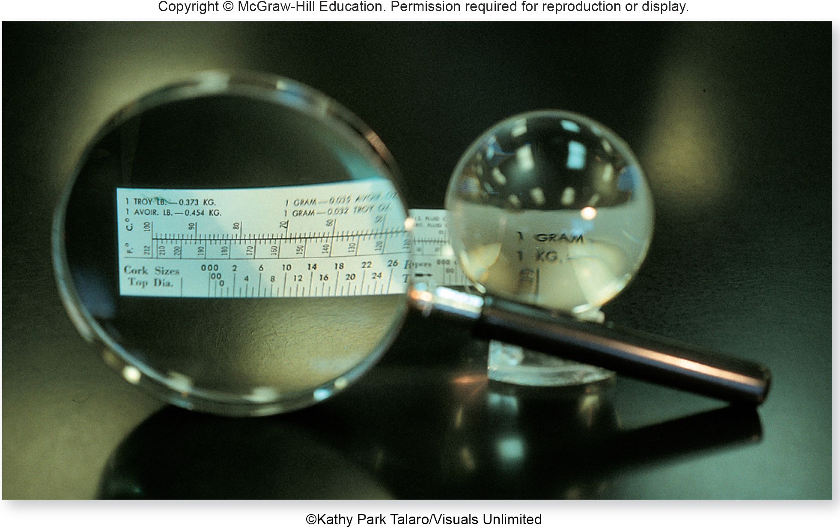
THERE ARE BASICALLY 3 TYPES of MICROSCOPES
SIMPLE LIGHT MICROSCOPES
They have one glass lens, and are also referred to as a magnifying glass.
Most can magnify 2-30 X

Slide 55
B) COMPOUND LIGHT MICROSCOPES - have 2 or more glass lenses in sequence that are used to look through. - the total magnifying power of a compound light microscope is determined by: multiplying the ocular lens power X the objective lens power. - the maximum magnification with a compound light microscope is about 2,000X. - most microscopic specimens that we see under a compound light microscope need to be stained to see them; staining adds color to normally colorless bacteria but it also KILLS the bacteria.

Slide 56
There are several types of compound light microscopes: a) bright field - the typical lab microscope b) phase contrast - allows better visualization of intracellular detail, cilia, and flagella moving in LIVE specimens c) dark field - allows us to see difficult to stain microbes and allows the detection of motility (syphilis used to be diagnosed with this type of microscope) d) fluorescent - commonly used in diagnostic microbiology and serology (the study of antibodies and antigens in serum and other body fluids)

Slide 57
COMPOUND LIGHT MICROSCOPE

Slide 58
Unstained vs. stained cheek cells looking through a bright field microscope.

Slide 59
Syphilis spirochetes see through a dark field microscope

Slide 60
Phase contrast microscopy

Slide 61
Fluorescent microscopy Staining to detect cytomegalovirus- the bright green areas are the virus covered with antibodies tagged with a fluorescent dye that target only cytomegalovirus.

Slide 62
C) ELECTRON MICROSCOPES - electromagnets replace glass lenses, specimens may need to be thin sectioned and they are in a vacuum (the specimen is dead) - TEM (transmission electron microscope) - used to see internal details of cells and organelles and to see viruses - can magnify up to 100,000,000 X (0.5nm resolution) - SEM (scanning electron microscope) - used to see the surfaces of specimens in a “3D” like appearance; can also see viruses - can magnify up to approximately 100,000,000 X (10nm resolution)

Slide 63
Electron microscopes

Slide 64
TEM micrograph SEM micrograph

